Slide 1
Difficulty Prediction for Multiple Choice Problems in Medical Exams
ADVISOR: JIA-LING, KOH
SOURCE: CIKM ’19
SPEAKER: kuan-yu, sheng
DATE: 2020/05/31

Slide 2
Outline
Introduction
Method
Experiment
Conclusion

Slide 3
Introduction
3
Goal :
Predict the difficulty of a multiple choice problem in medical exam.
DAN
Difficulty of the question
1.Questions
2.Choices
3.Answer

Slide 4
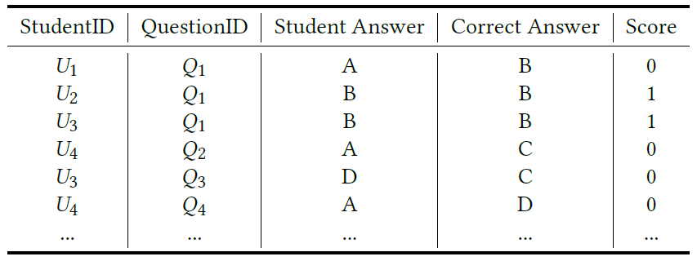
Introduction
4
The difficulty of a question :
The real difficulty of Q1:
1/3 = 0.333
Notes:
如何定義一個問題的難度

Slide 5
Introduction
5
Three important component :
A database of medical papers and textbooks (Medical document DB).
Enrich the representation of the choices.
Definition of difficulty.
Recall (correct answer)
Confusion (the other choices)
Real-world data set from one of the largest medical online education web sites in China.
Notes:
200萬 醫學篇論文、518醫學課本.
Recall : 此問題在文章中容易找到嗎?
Confusion : 此誘答選項+相關文件是否跟解答相似度高
資料集來自中國最大線上醫學教育網站

Slide 6
Outline
Introduction
Method
Experiment
Conclusion

Slide 7
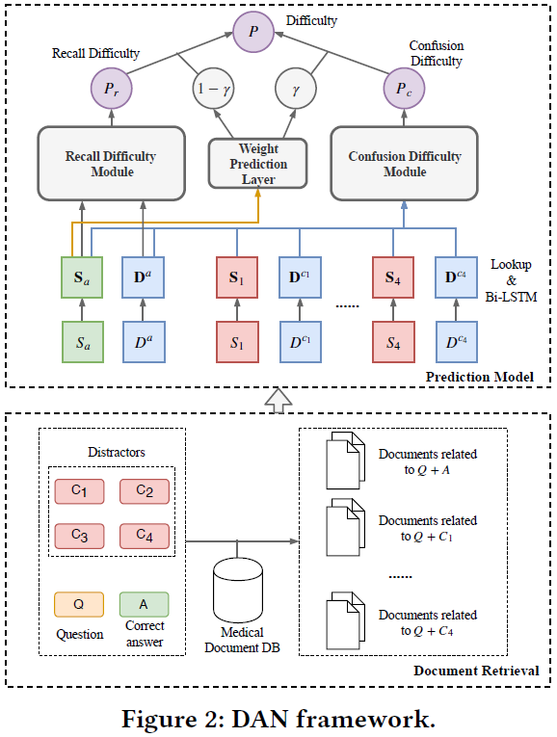
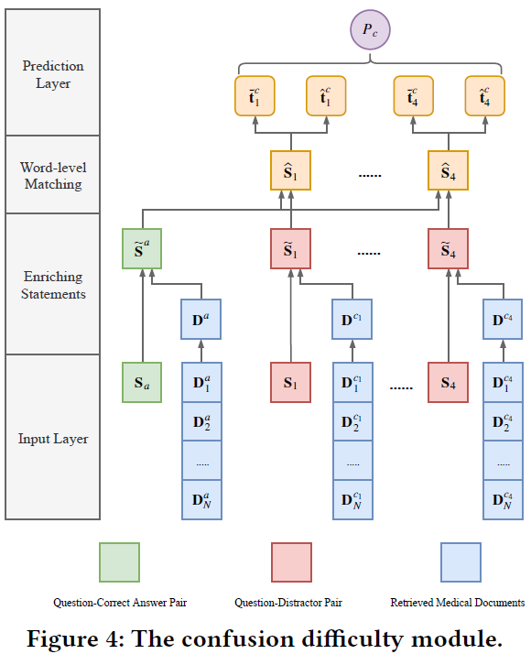
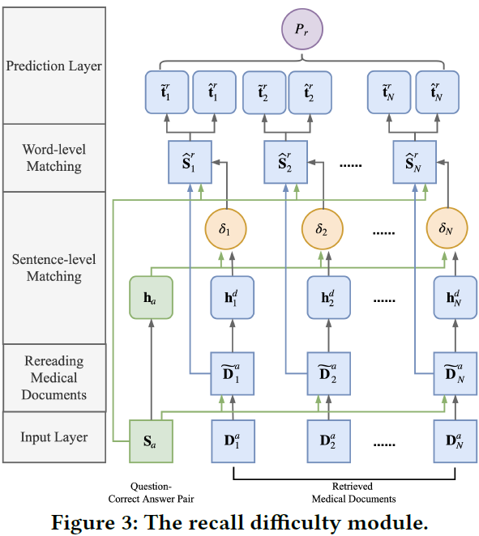
Method
Model over view

Slide 8
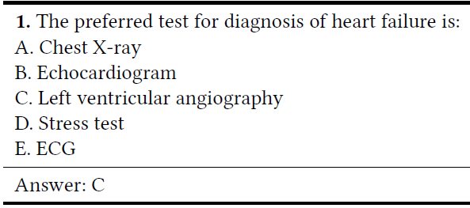
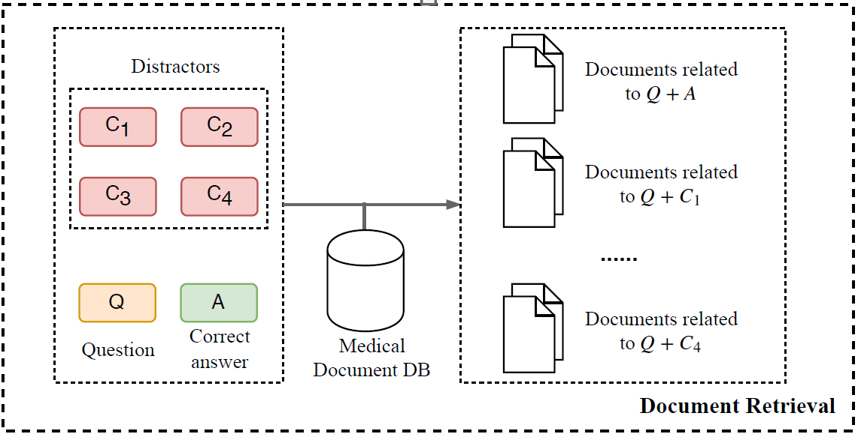
Method
Document Retrieval

Slide 9
Method
Document Retrieval
By BM25
Notes:
W 為 100維

Slide 10
Method
Document Retrieval
BM25 :
Calculate the similarity between Query (Sa , S1 , S2 , S3 , S4) and Document (in Medical Document DB)
Query={q1,q2…..qt}
$f_{i}$ = the possibility of word $q_{i}$ appear in Document d
${qf}_{i}$ = the possibility of word $q_{i}$ appear in Query q
Notes:
N表示文本集合中文本的总数量
n(qi)表示包含qi这个词的文本的数量
0.5主要是做平滑处理
k1,k2, b都是可调节的参数
dl:文本d的长度
avgdl为文本集D中所有文本的平均长度。
一般qfi = 1 , k2=0，則第二項不見。
通常k1=1 , b=0.75(調節文本長度相關性影響)

Slide 11
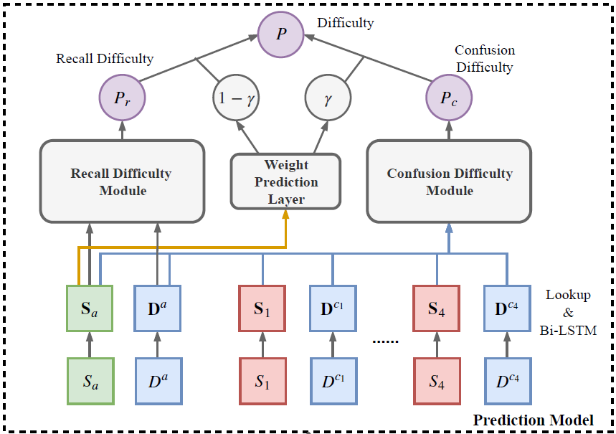
Method
Prediction model - Encoding part
Lookup part :
convert word w to its d-dimensional vector e via an
embedding matrix E ∈ R|V |×d , V is the vocabulary.
Bi-LSTM part :
Input: $S_{a}$ ∈ R|$L_{Q}$| × d
Output: $S_{a}$ ∈ R|$L_{Q}$| × d
Input: $S_{i}$ ∈ R|$L_{D}$| × d
Output: $S_{i}$ ∈ R|$L_{D}$| × d
Notes:
D = 200維

Slide 12
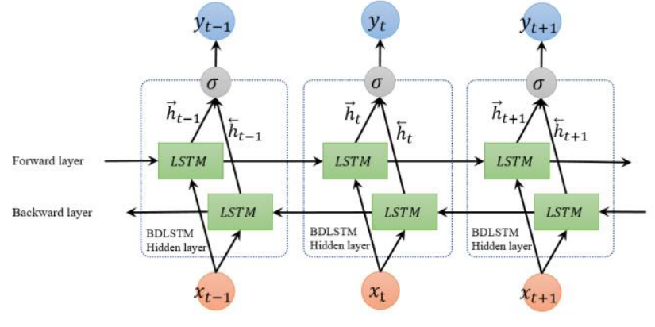
Method
Prediction model - Encoding part
LSTM :
Bi-LSTM :
Notes:
Zp、Zd:100維

Slide 13
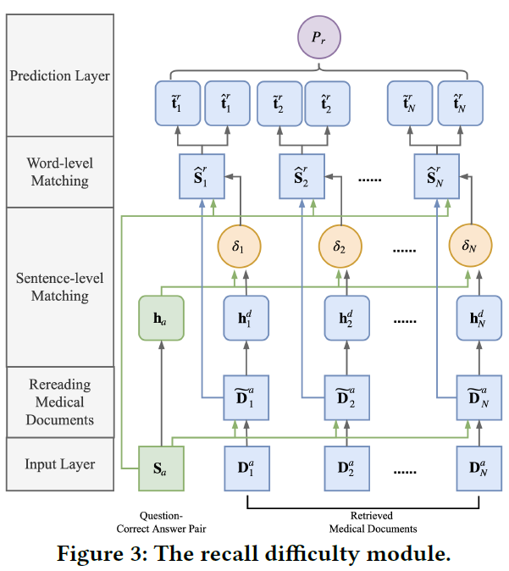
Method
Recall Difficulty module
Rereading Medical Document:
Notes:
column-wise concatenation
- denotes the elementwise subtraction between two matrices.

Slide 14
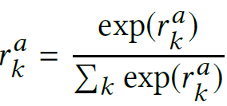
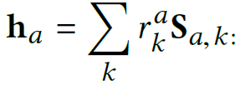
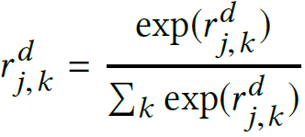
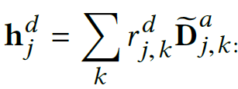
Method
Recall Difficulty module
Sentence-level Matching(Answer part) :
Sentence-level Matching(Document part) :
Notes:
k-th row
Wa ∈ R d×1,
Wd ∈ R d×1,
ba ∈ R,
Bd ∈ R

Slide 15
Method
Recall Difficulty module
word-level Matching :
Notes:
Sa對Dj做attention，讓Dj根據Sa學習attention weight reweight自己並且讓Dj的維度跟Sa對齊
Wrm ∈ R 2d×d
brm ∈ R d
得到綜合sentence level 以及word level的 代表Q-A以及第j個文件的相似度

Slide 16
Method
Recall Difficulty module
Prediction Layer :
Notes:
Wr1 ∈ R 2Nd×h,
Wr2 ∈ R h×1,
br1 ∈ R h, and br2 ∈ R are trainable parameters.

Slide 17
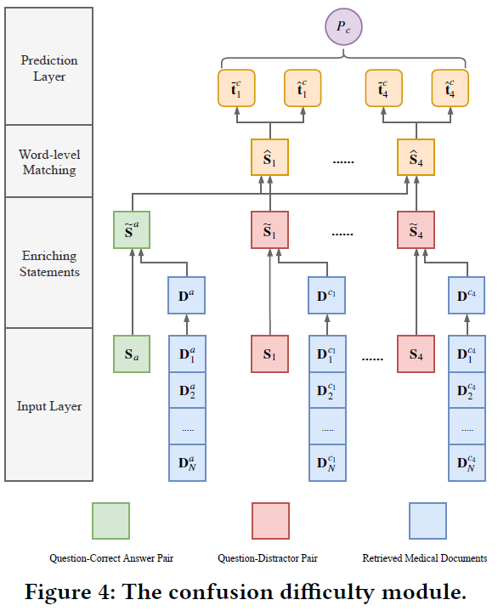
Method
Confusion difficult module
Enriching Statement:
Notes:
[|] denotes the row-wise concatenation.
Attn : 將document的資訊帶進Q-Acontext
得到富含語意資訊

Slide 18
Method
Confusion difficult module
Word-Level Matching:

Slide 19
Method
Confusion difficult module
Prediction Layer:
Notes:
row-wise mean-pooling and row-wise max-pooling
Where Wc 1 ∈ R 8d×h and
Bc 1 ∈ R h are the parameters to learn.

Slide 20
Method
Weight Prediction Layer
Prediction Layer:
Notes:
Where Wc 1 ∈ R 8d×h and
Bc 1 ∈ R h are the parameters to learn.

Slide 21
Method
Loss Function

Slide 22
Outline
Introduction
Method
Experiment
Conclusion

Slide 23
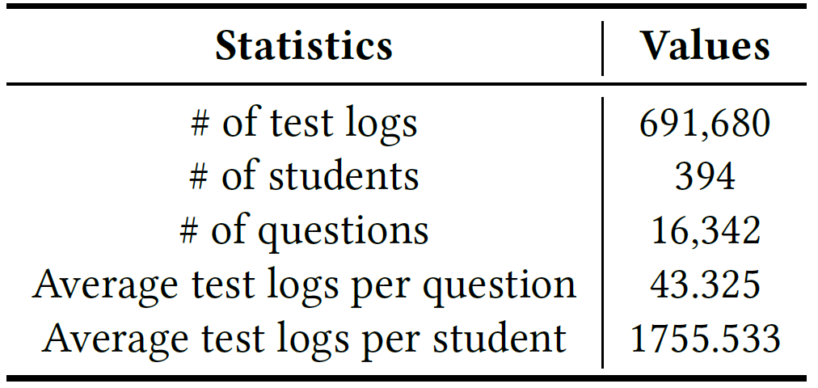
EXPERIMENT
23
Datasets
Largest medical online education websites in China.
This dataset consists of more than 800,000 test.
Collected from September 2017 to July 2018.
Notes:
公開的數據集MIMIC-III
醫生在最初24小時內為每位患者開出的藥物
TWOSIDES數據集的DDI知識
排名前40位的嚴重DDI類型

Slide 24
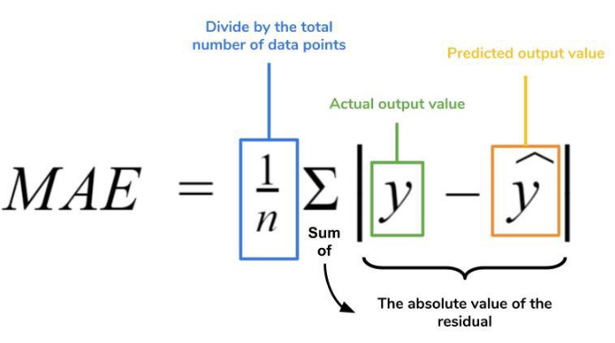
24
EXPERIMENT
Performance Metrics
Root Mean Squared Error(RMSE) and Mean Absolute Error(MAE).
Spearman Rank Correlation Coefficient(SCC).
Kendall Rank Correlation Coefficient(KCC).
Notes:
We use RMSE and MAE to measure the distance between the predicted difficulty and the real difficulty. Values closer to zero indicate better performances.
We use SCC to measure the correlation between predicted difficulties and real difficulties. The larger the SCC is, the better performance the model has.
Kendall Rank Correlation Coefficient[7] is also widely used in many regression problems in NLP[20]. We use it as another rank-based performance metric.

Slide 25
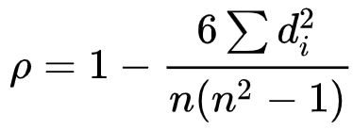
25
EXPERIMENT
Performance Metrics
Spearman Rank Correlation Coefficient(SCC).
Example:
Student | Test score | Technical score | Test rank(xi) | Technical Rank(yi)
A | 60 | 510 | 5 | 5
B | 70 | 530 | 4 | 4
C | 80 | 560 | 3 | 3
D | 90 | 580 | 2 | 2
E | 100 | 1000 | 1 | 1

Slide 26
26
EXPERIMENT
Performance Metrics
Kendall Rank Correlation Coefficient(KCC)
Example:
Student | Test score | Technical score | Test rank(xi) | Technical Rank(yi)
A | 60 | 510 | 5 | 5
B | 70 | 530 | 4 | 4
C | 80 | 560 | 3 | 3
D | 90 | 580 | 2 | 2
E | 100 | 1000 | 1 | 1

Slide 27
EXPERIMENT
27
RESULTS
Compare with other baseline
Notes:
SVM : SVM+TF-IDF
Bi-LSTM : Bi-LSTM + Fully connected
TACNN : 一個英文測驗難度預測模型
DANR : 只有知識難度的那個
DANC : 只有誘答選項的那個

Slide 28
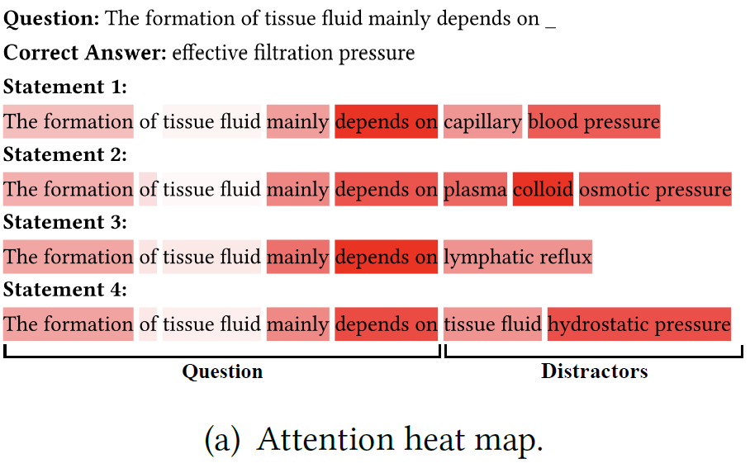
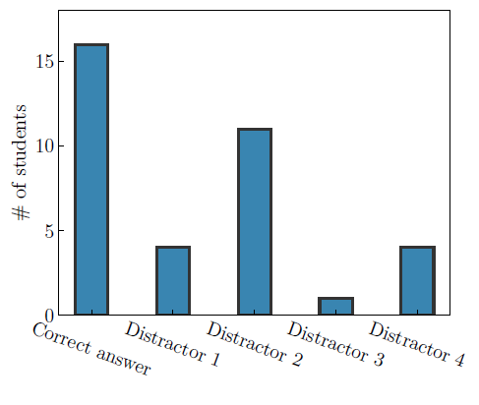
EXPERIMENT
28
RESULTS

Slide 29
Outline
Introduction
Method
Experiment
Conclusion

Slide 30
Conclusion
We propose a novel Document enhanced Attention based neural Network(DAN) framework to automatically predict question difficulty for multiple choice problems in medical exams.
Now, we only apply the DAN in medical exams, but it can be easily adapted to the multiple choice problems of other domain.

